Slide 1
COMP1003 – Algorithms, Data Structures & Maths
Session 04
Proofs, Sums, Limits, Metrics
Thomas Wennekers
University of Plymouth

Slide 2
Overview
Algorithms on Numbers
Proofs
Series, sums and limits
Metrics and distances

Slide 3
Numbers, Proofs and Algorithms

Slide 4
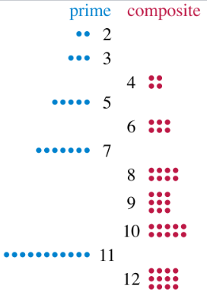
Prime Numbers
Definition: A prime is any natural number larger than 1 that can only be divided by 1 and itself without remainder.
Primes are central in many Computer Science algorithms, especially encryption.
A natural number not prime is composite.

Slide 5
Prime Factorisation
1 is not prime to exclude 1x1
No number could be prime else
Each natural number has a factorization into primes
Prims factorisation is unique up to multiplicities, eg 12 = 2*2 * 3
Factorisation is “expensive”

Slide 6
Prime Numbers
Any natural number larger than 1 that can only be divided by 1 and itself without remainder.
Is there a largest prime ?

Slide 7
Prime Numbers
Is there a largest prime ? No!

Slide 8
Proofs
Maths uses different ways to proof theorems.
Direct proof using axioms & equivalences
Proof by exhaustion (list all cases)
Proof by contradiction (modus tollens)
Mathematical induction
..
These are all logically sound

Slide 9
Theorem: There are infinitely many primes (Euclid 300BC)
Proof: Consider any finite list of primes p1,p2…pn
Show that there is at least 1 more prime

Slide 10
Theorem: There are infinitely many primes (Euclid 300BC)
Proof: Consider any finite list of primes p1,p2…pn
Show that there is at least one more prime
Define P = p1*p2* … *pn; let q := P+1
Case 1: q is prime. Done !
Case 2: q is not prime → Some p divides q.
If p is in the original list it divides P and P+1. It then must also divide the difference, 1, which is impossible.
By contradiction p is not in the original list. Done!

Slide 11
q | p and q | r → q | (p-r)
Example:
3|15 and 3|9 → 3 | (15-9) = 6 ok

Slide 12
q | p and q | r → q | (p-r)
Proof:
q | p → there is an s1 such that q*s1=p
q | r → there is an s2 such that q*s2=r

Slide 13
q | p and q | r → q | (p-r)
Proof:
q | p → there is an s1 such that q*s1=p
q | r → there is an s2 such that q*s2=r
→ p-r = q*s1 – q*s2 = q*(s1-s2)
→ q divides p-r
Done! This is a direct proof

Slide 14
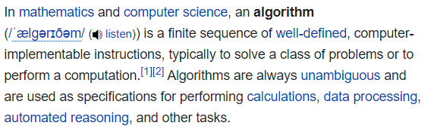
Algorithms
Maths does not need to define functions this way
‘Unambiguous’ does not imply deterministic results

Slide 15
Sieve of Eratosthenes
Compute all primes up to a given number N
How?

Slide 16
Sieve of Eratosthenes
Compute all primes up to a given number N
For all numbers k from 2 to N
strike out all multiples of k <= N
This does not even need multiplication

Slide 17
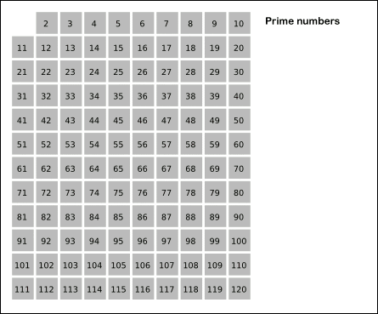
Sieve of Eratosthenes

Slide 18
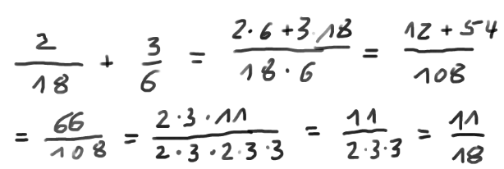
Greatest Common Divisor
Problem: For two natural numbers determine the largest common factor (divisor) in both of them
Application: adding fractions

Slide 19
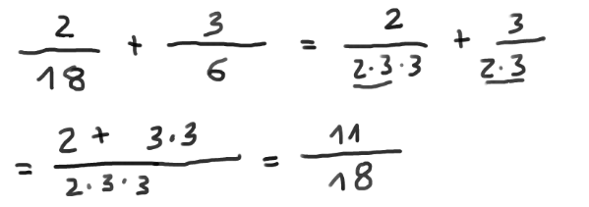
Greatest Common Divisor
Problem: For two natural numbers determine the largest common factor (divisor) in both of them
Application: adding fractions (easier)

Slide 20
Greatest Common Divisor
Euclidean Algorithm
Problem: For two natural numbers determine the largest common factor (divisor) in both of them
Remember: q | p and q | r → q | (p-r)
→ If p>r we can replace p by p-r
and do not change the GCD

Slide 21
Greatest Common Divisor
Euclidean Algorithm
Problem: For two natural numbers determine the largest common factor (divisor) in both of them
Remember: q | p and q | r → q | (p-r)
→ If p>r we can replace p by p-r
and do not change the GCD
if p==r → p must be the GCD

Slide 22
Greatest Common Divisor
Euclidean Algorithm
Problem: For two natural numbers determine the largest common factor (divisor) in both of them
Remember: q | p and q | r → q | (p-r)
→ If p>r we can replace p by p-r
and do not change the GCD
if p==r → p must be the GCD
else: repeatedly applied we end up with the GCD

Slide 23
Integer division
N or Z are not closed under division
2/3 = .66666.. means division over the Reals, R
Integer division discards remainders
5/3 = 1 (Remainder 2)
These two divisions can be mixed in code in which case often implicit type conversions occur! This can cause nasty bugs!!
(5/3) * 1.33 = ?? 2.66 or 3.33 ?

Slide 24
Modulo operation %
a mod n returns the remainder of a/n
9 mod 3 = 0 9 mod 2 = 1
9 mod -3 = 0 -9 mod 3 = 0
9 mod -2 = -1 -9 mod -2 = -1 by definition

Slide 25
Modulo operation %
a mod n returns the remainder of a/n
9 mod 3 = 0 9 mod 2 = 1
9 mod -3 = 0 -9 mod 3 = 0
9 mod -2 = -1 -9 mod -2 = -1 by definition
Used on finite grids because (k mod N) wraps
mod induces an equivalence relation on N or Z

Slide 26
Series, Sums and Limits

Slide 27
The Staircase Problem
A staircase has N steps
You can take one or two steps at once.
How many possibilities are there to reach the top?
1111111
211111
121111
22111
…….. Tricky to count all the options

Slide 28
Use Recursion
Recursion defines or solves a problem by making reference to itself (often for smaller sub-problems).
Example : factorial function
2! = 1*2
3! = 1*2*3 = 2! * 3
n! = 1*2*3*….*(n-1)*n = (n-1)! * n
The last line defines n! in terms of (n-1)!

Slide 29
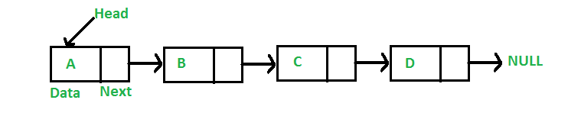
Use Recursion
Recursion defines or solves a problem by making reference to itself (often for smaller sub-problems).
Example 2 : List data structure of some elements:
A list is empty or an Element followed by a list

Slide 30
Use Recursion
Back to the staircase problem
If we would know how many possibilities there are for n-1 and n-2 steps we could say
There is one option to get from step n-1 to n
and there is one more option to get from n-2 to n
Therefore the number of options for n steps is
N (n) = N (n-1) + N (n-2)

Slide 31
Use Recursion
…
Therefore the number of options for N steps is
N (n) = N(n-1) + N(n-2)
For n=1 we have 1 option 1
For n=2 we have 2 options 11,2
From this we can compute N(n) quickly
(there even is an explicit solution)

Slide 32
Fibonacci Sequence
The solution is the famous Fibonacci sequence
It is a recurrence equation: new values of a sequence are computed based on previous ones
1, 2, 3, 4, ?
2, 6, 15, 31, ?
Recurrence equations are quite common in the analysis of (recursive) algorithms.

Slide 33
Fibonacci Sequence
The solution is the famous Fibonacci sequence
It is a recurrence equation: new values of a sequence are computed based on previous ones
1, 2, 3, 4, ? x(n+1) = x(n)+1 ; x(0)=1
1, 2, 6, 15, 31, ? X(n+1) = x(n)+n² ; x(0)=1
Recurrence equations are quite common in the analysis of (recursive) algorithms.

Slide 34
Sums
Instead of series one often has to consider sums
S(n) = 1 + 2 + 3 + 4 + …. + n
What is S(100) ?

Slide 35
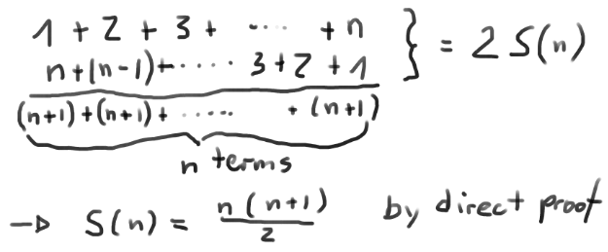
Sums
Instead of series one often has to consider sums
S(n) = 1 + 2 + 3 + 4 + …. + n
What is S(100) ? … Naïve summation is slow, but

Slide 36
Proof by Induction
Proposition: S(n) = n(n+1)/2
n=1: S(1) = 1*2/2 = 1 ok
2) Assume S(n) is correct. Then:
S(n+1) = S(n) + (n+1) = n(n+1)/2 + (n+1)
= (n+1) ( n/2 +1) = (n+1)(n+2)/2 ok
3) The proposition follows by induction from 1&2

Slide 37
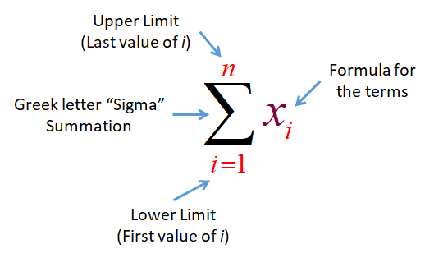
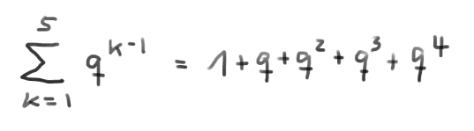
Sigma Notation of Sums
Example:

Slide 38
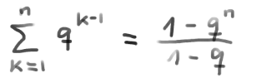
Can you proof this?
it’s called the geometric sum

Slide 39
Can you proof this?
it’s called the geometric sum
left as an exercise

Slide 40

Limits
We are often interested in how a series behaves for large n also called asymptotically
1, 2, 3, 4, 5 …. diverges to infinity
1, 1, 1, 1, 1 …. ‘approaches’ 1
1, ½, 1/3, ¼ … approaches 0
-1 1 -1 1 -1 … does not converge

Slide 41
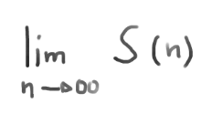
Limits Notation
For some expression S(k) depending on k, the limit of S(k) when k approaches infinity is denoted as

Slide 42
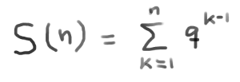
Limits Notation
For some expression S(k) depending on k, the limit of S(k) when k approaches infinity is denoted as
Example: = ?

Slide 43


Limits Notation
For some expression S(k) depending on k, the limit of S(k) when k approaches infinity is denoted as
=
Example: = (from earlier)
Convergence requires |q|<1.

Slide 44
Metrics and Distances

Slide 45
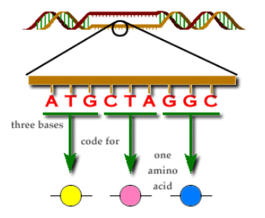
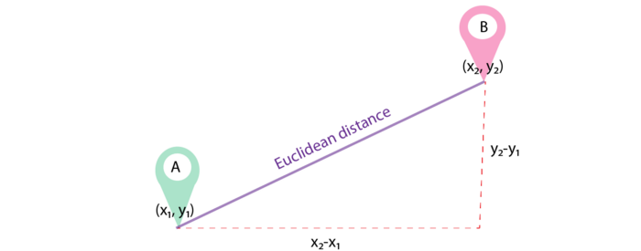
Distances
Many computational problems require the computation of distances between elements
Genetic codes
Spatial Euclidean distance

Slide 46
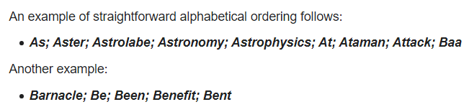
String Ordering cf last Session about Order
The set of strings can be ordered according to the common dictionary or alphabetic order
A < a < aa < B < BBbcd < C…. < zzzzzz
→ useful for search algorithms

Slide 47
String Distances
The set of strings is also a set with a distance, where each two strings have a distance.

Slide 48
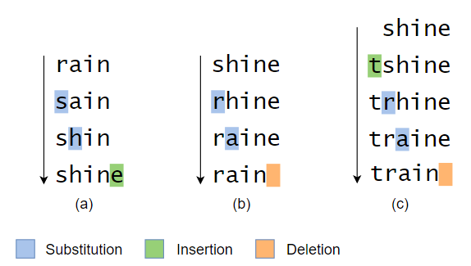
String Distances
The set of strings is also a set with a distance, where each two strings have a distance.
Distances between symbol sequences could be measured by the number of point changes required to match to strings (“Edit distance”)

Slide 49
String Distances
The set of strings is also a set with a distance, where each two strings have a distance.
→ useful for similarity checking
eg text comparison or error correction
There are many ways to measure string distances

Slide 50
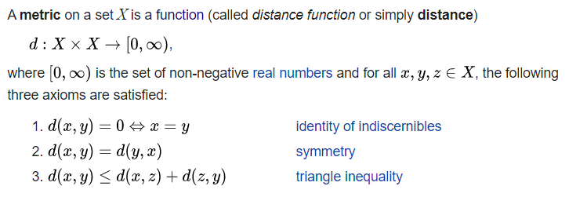
Mathematical Metric
A metric is a function that defines a distance between each two points of a set A
A set with a metric is called a metric space

Slide 51
Absolute Distance on R
d(x,y) := | x – y |
= absolute difference between x and y
= x if x>=0 and –x else
This is the common distance on R

Slide 52
Absolute Distance on R
d(x,y) := | x – y |
Check definition of metric: for all x, y, z in R
x=y <-> x-y = 0
| x – y | = | y - x |
| x – y | = | x – z + z – y | <= |x – z| + |z – y |
because |x+y| <= |x| + |y| for all x,y
(proof by 2 cases: y>=x or not)

Slide 53
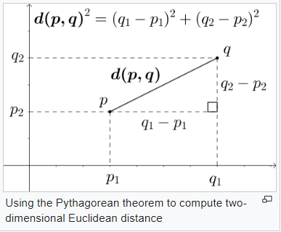
Euclidean Distance/Metric
Check conditions
p=q <-> d(p,q)=0
d(p,q) = d(q,p)
Somewhat lenghty
Similar for higher dimensions
This is the common spatial distance

Slide 54
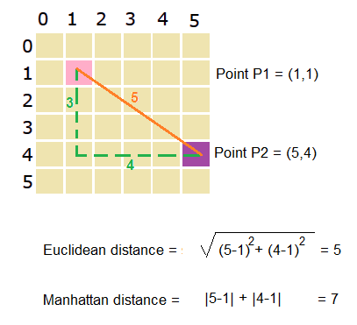
Manhattan Metric
d( x, y ) := |x1-y1| + |x2-y2|
x = (x1, x2); y = (y1, y2) -> Worksheet 2

Slide 55
Summary
Proofs make Maths solid
Some tools: recurrences, sums, limits
Metric spaces important in Computing
  The numbers systems
  The plane and 3D space
  Strings and sequences

